Slide 1


Department of Artificial Intelligence and Machine Learning
Personalized Marketing Strategies: Leveraging Ensemble methods and Collaborative Filtering for Targeted Promotions
Dr.V.SARAVANANKUMAR
Professor
HARSAVARDHINI R(221801016)
KAVIYA S(221801024)

Slide 2
Problem Statement and Motivation
A retail chain wants to personalize promotions and discounts by analyzing customer purchase history and preferences. They aim to increase sales and customer satisfaction.
The motivation of this project is to overcome the limitations of the traditional marketing approaches by enhancing the retail chain's marketing effectiveness and customer engagement through personalized promotions and discounts.

Slide 3
Objectives
The primary objective of our project is to increase sales and customer satisfaction by analyzing customer purchase history and preferences
Encouraging customers to make more purchases by providing personalized promotions and discounts.

Slide 4
Abstract
The project aims to boost sales and customer satisfaction for a retail chain by personalizing promotions and discounts based on customer purchase history and preferences. Success will be measured through metrics such as increased sales, improved customer satisfaction, higher engagement rates with promotions, and redemption rates of discounts. To achieve this, the project involves collecting and analyzing customer data to identify purchasing patterns and preferences, developing a recommendation engine using machine learning to generate tailored promotions along with discounts, and testing and optimizing these promotions based on performance feedback. Integration into existing marketing channels will ensure effective deployment and continuous improvement.

Slide 5
Introduction and Overview of the Project.
In the retail industry, personalized promotions are key to enhancing customer engagement and driving sales. Traditional promotional strategies often rely on broad, uniform discounts that fail to address the specific needs and preferences of individual customers
This project aims to revolutionize promotional strategies by developing a system that leverages customer purchase history and preferences for personalized promotions.
By employing advanced data analytics and machine learning algorithms like Random Forest Classifier, Collobrative Fitering ,Gradient Boosting.They segment customers and deliver tailored offers along with recommendations, optimizing marketing resources and improving customer satisfaction.

Slide 6
Literature Survey
S.No | Author Name | Paper Title | Description | Journal | Volume/ Year
1. | Bayu Yudha Pratama,Indra Budi,Arlisa Yuliawati | Product Recommendation in Offline Retail Industry by using Collaborative Filtering | Memory-based collaborative filtering (k-NN) excels over model-based methods (SVD) in offline retail recommendations using implicit feedback from purchase data. | International Journal of Advanced Computer Science and Applications | 2020
2. | Mahmoud SalahEldin Kasem,Mohamed Hamada,Islam Taj-Eddin | Customer Profiling, Segmentation, and Sales Prediction using AI in Direct Marketing | A data mining preprocessing method for customer profiling using RFM analysis, boosting trees, and SVM improves sales through enhanced segmentation and behavior prediction. | IEEE Journal | 2023
3. | Angela Hsiang‑Ling Chen, Sebastian Gunawan | Enhancing Retail Transactions: A Data‑Driven Recommendation Using Modified RFM Analysis and Association Rules Mining | A recommendation system using modified RFM, K-means clustering, and classification enhances retail predictions based on customer and product behaviors. | Applied sciences journal | 2023
4. | Emre Yildiz,Ceyda Gungor,Eyup Ensar Isik | A Hyper-Personalized Product Recommendation SystemFocused on Customer Segmentation: An Application in theFashion Retail Industry | A fashion retail recommendation system uses RFM, k-means, and Apriori, with potential for broader datasets, varied sectors, and enhanced customer parameters in future studies. | Journal of theoretical and applied electronic commerce research | 2023
5. | Ghulam Mustafa,Naveed Ahmad Jhamat,Zeeshan Arshad | OntoCommerce: Incorporating Ontology and Sequential Pattern Mining for Personalized E-Commerce Recommendations | A hybrid recommender system using ontology and sequential pattern mining (SPM) improves personalized e-commerce recommendations, addressing cold-start and data sparsity issues. | IEEE journal | 2024

Slide 7
Existing Sytem
Collaborative Filtering: Platforms like Amazon and Flipkart recommend products using user-based and item-based filtering, based on purchase history and browsing behavior (e.g., “Frequently Bought Together” suggestions).
Dynamic Discounts: Personalized discounts are offered for specific user groups, such as high-spenders, cart abandoners, or first-time buyers, encouraging targeted purchases.
Context-Aware Promotions: Recommendations and promotions change dynamically based on factors like seasonal trends, festivals, regional preferences, or time of day (e.g., festive sales during Diwali).
Loyalty Programs: Systems provide incentives like cashback, coupons, or exclusive deals for loyal customers, enhancing engagement and retention .

Slide 8
Drawback of Existing System
Current systems typically offer the same promotions to all customers, failing to tailor discounts or offers to individual preferences or purchasing habits, leading to reduced engagement and conversion rates.
Lack of Integration Between Recommendations and Promotions
Traditional recommendation engines often function independently of promotional strategies, missing opportunities to combine personalized recommendations with targeted discounts to increase sales.
Static and Limited Customer Insights
Existing systems rely on outdated segmentation models like RFM (Recency, Frequency, Monetary), which cannot dynamically adapt to changes in customer behavior or incorporate real-time data for decision-making.

Slide 9
System Architecture

Slide 10
Proposed System
The proposed system aims to enhance the retail chain's ability to personalize promotions and discounts by analyzing customer purchasing behavior and preferences .
Increasing the overall sales and customer satisfaction by predicting the next likely product a customer will purchase by using Random Forest classifier , user based and item based colloborative filtering methods for providing recommendations along with discounts and promotions based on user and item similarity and next product the customer is likely to buy

Slide 11
List of modules
1. Data Preprocessing Module
2. Predictive Modeling Module
i)Next Purchase Prediction and promotion
3. Recommendation Engine Module
i)User based promotions and discounts ii)Item based promotions and discounts
4. Promotion Personalization Module
5.Analytics and reporting Module

Slide 12
Module1:Data Preprocessing
Step 1: Use df.isnull().sum()/df.shape[0]*100 to find the percentage of null values in each column.
Step 2: Analyze the correlation heatmap to identify columns with low correlation (close to 0).
Step 3: Remove columns with high null percentages and low correlation (e.g., Postal Code and Discount)
Step 4: Verify null values and correlation after removal to ensure data quality.
Step 5: Use the cleaned dataset for further analysis or predictive modeling.

Slide 13
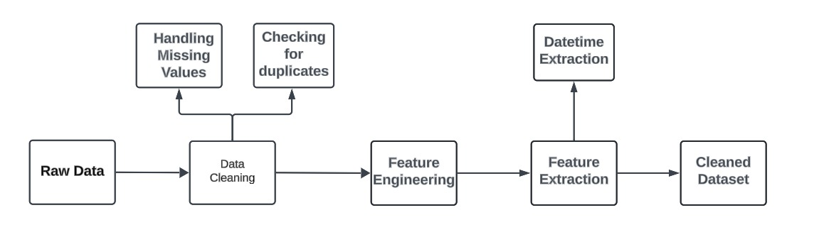
Module 1:DFD Diagram

Slide 14
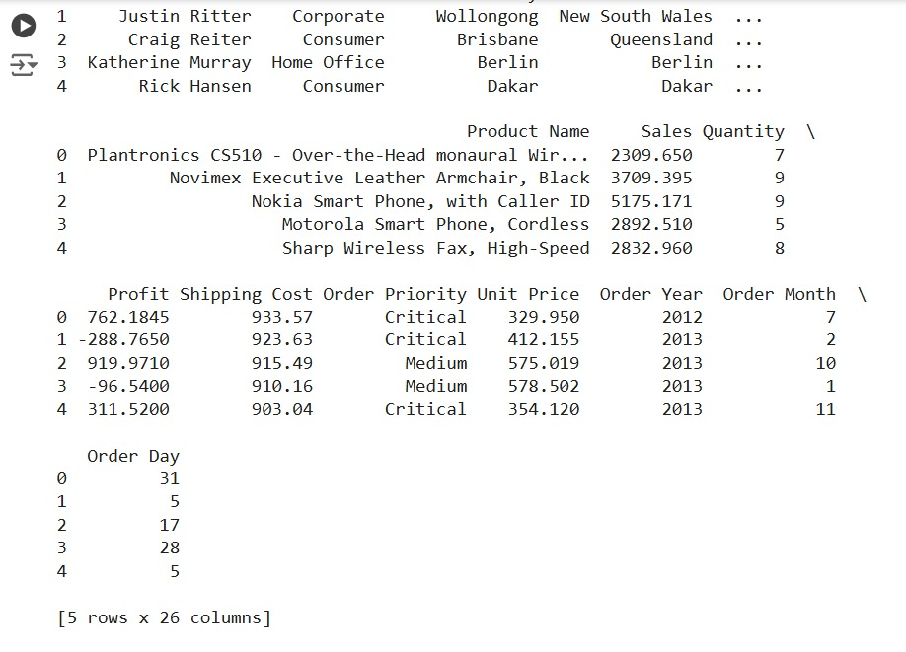
Output Screenshot

Slide 15
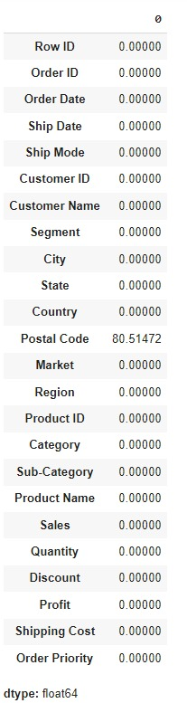
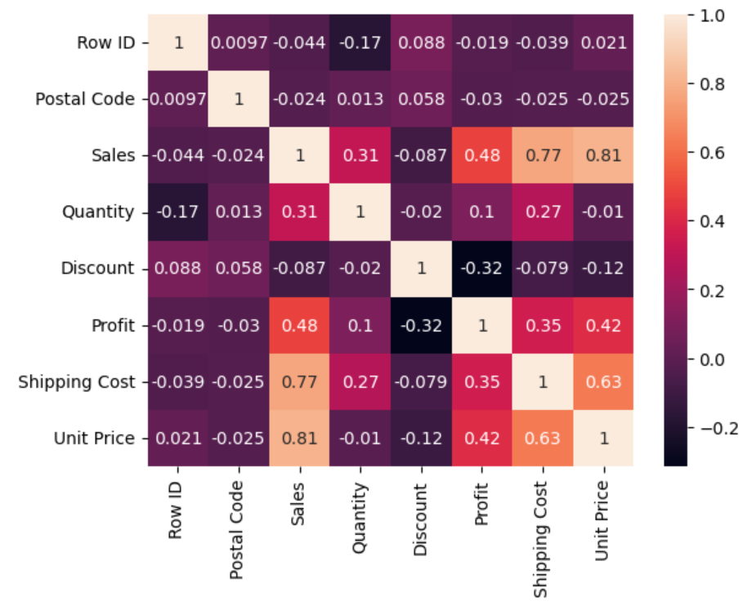
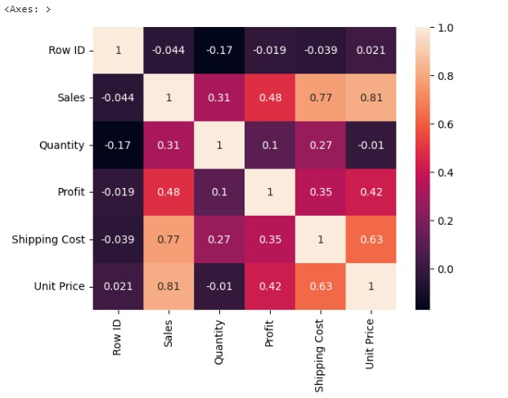
Output Screenshot

Slide 16


Module 2(i):Predictive Modeling
Step 1:Compute the entropy of the dataset based on the probability distribution of product/category purchases using the formula:
where pi is the probability of a product/category. Step 2:For a chosen feature (e.g., Order Month), calculate the information gain by subtracting the weighted entropy of the split from the original entropy:
H(D) is the original entropy and H split is the entropy after the split.
Step 3: After predictions, use a confusion matrix to calculate accuracy:

Slide 17
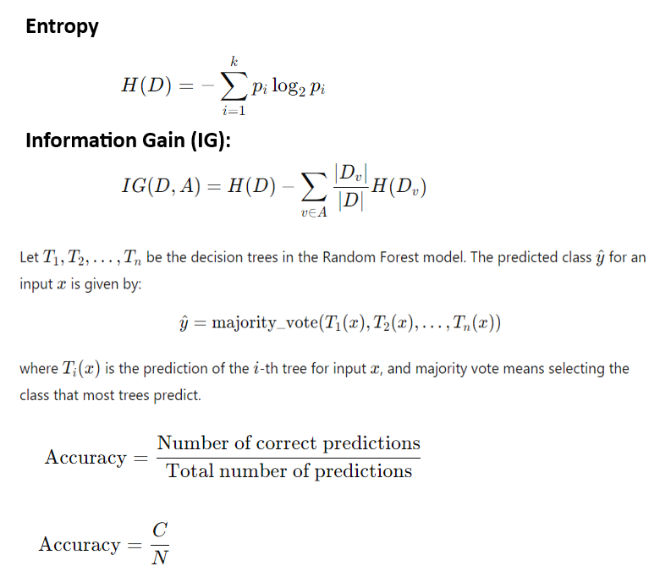
Next Purchase Prediction(calc.)

Slide 18
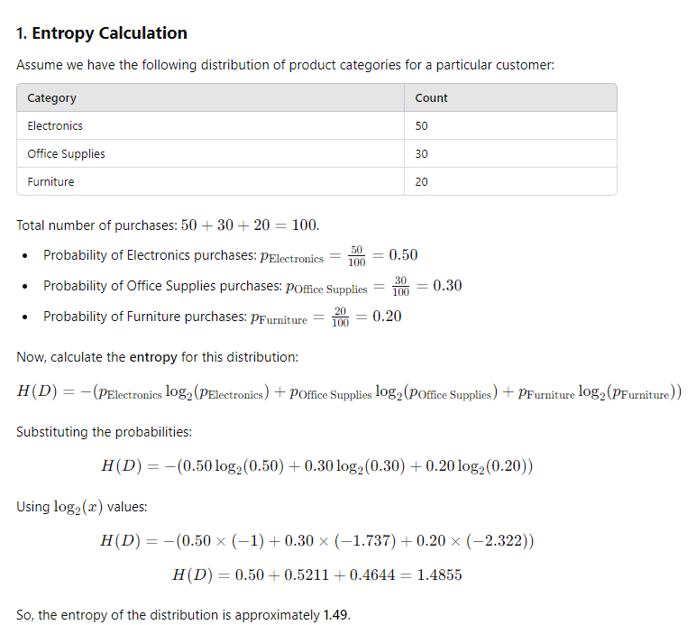
Next Purchase Prediction(calc.)

Slide 19
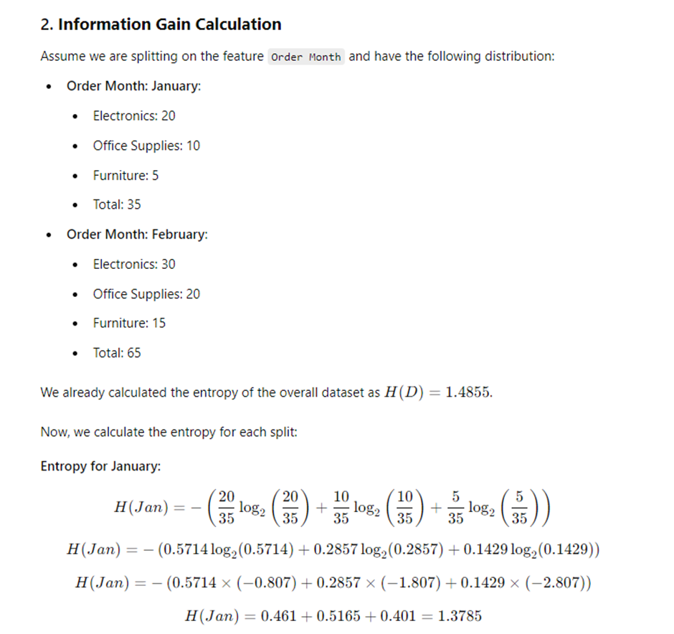
Next Purchase Prediction(calc.)

Slide 20
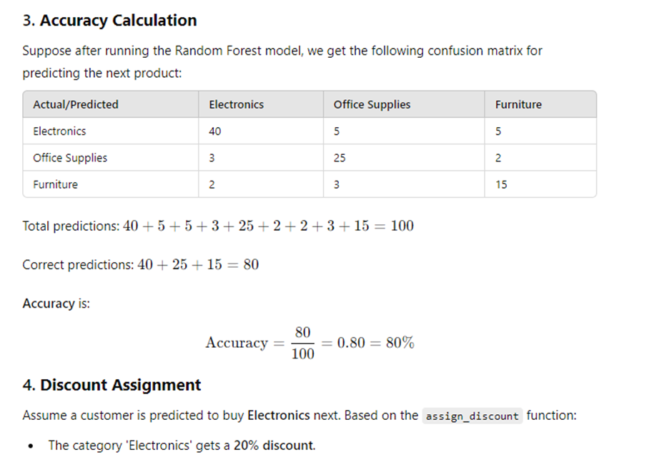
Next Purchase Prediction(calc.)

Slide 21
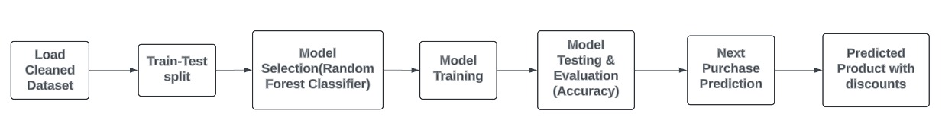
DFD Diagram - Predictive modeling
Next Purchase Prediction

Slide 22
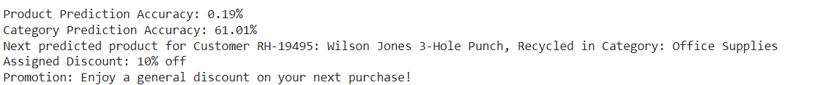
Output Screenshot
Next Purchase Prediction

Slide 23
Module 3(i):Recommendation module
User-Based Collaborative Filtering:
Step 1: Load dataset, filter by Customer ID, Product ID, and Quantity.
Step 2: Convert data to Surprise format, using Quantity as the rating.
Step 3: Train a user-based collaborative filtering model with KNN.
Step 4: Predict ratings for products the customer hasn’t purchased yet.
Step 5: Convert ratings to purchase probabilities (percentage).
Step 6: Assign discounts based on rating thresholds (30%, 20%, or 10%).
Step 7: Returns top-k recommended products with probabilities and discounts.

Slide 24
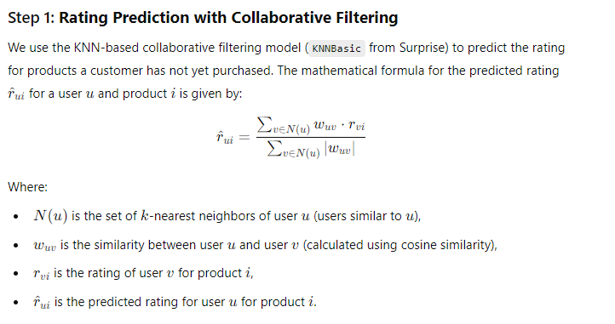
User based Promotion and discount(Calc.)

Slide 25
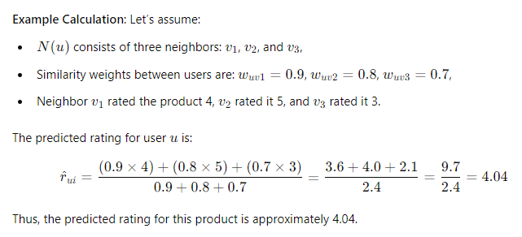
User based Promotion and discount(Calc.)

Slide 26
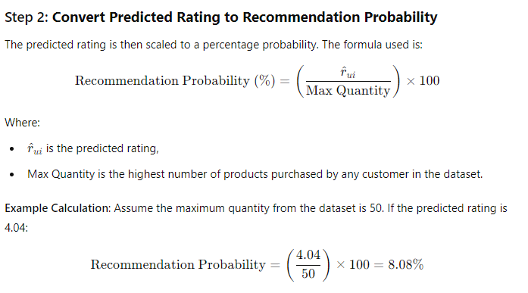
User based Promotion and discount(Calc.)

Slide 27
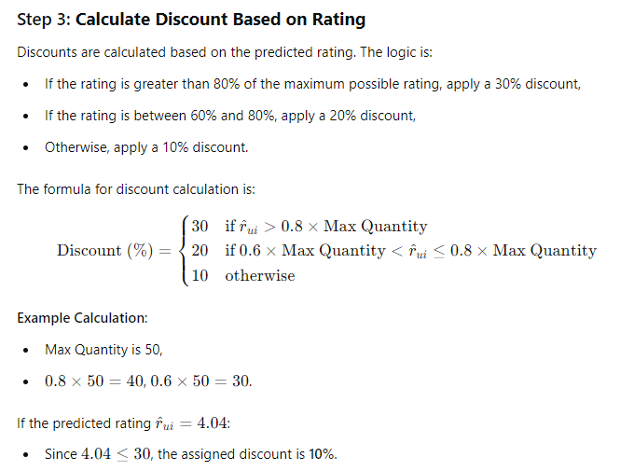
User based Promotion and discount(Calc.)

Slide 28
Module 3(ii):Recommendation module
Item-Based Collaborative Filtering:
Step 1: Load the dataset and filter it by Customer ID, Product ID, and Quantity.
Step 2: Convert the filtered data to the Surprise format, using Quantity as the rating scale.
Step 3: Train an item-based collaborative filtering model using KNN with cosine similarity.
Step 4: Identify all products that the specific customer has previously purchased.
Step 5: For each purchased product, predict ratings for similar products that the customer hasn't interacted with yet.
Step 6: Convert predicted ratings to recommendation probabilities (percentage) based on the maximum quantity in the dataset.
Step 7: Assign discounts based on recommendation probability thresholds (e.g., 20% for >70%, 10% for 50-70%, and 5% for <50%).
Step 8: Return the top-k recommended products along with their probabilities and associated discounts

Slide 29
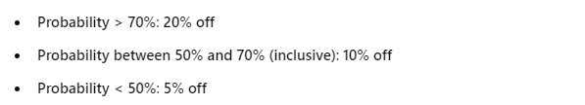
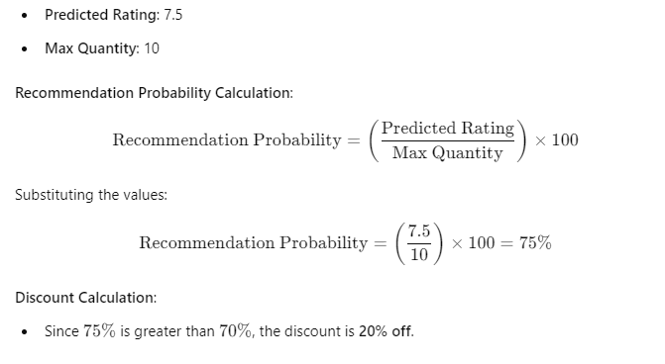
Item based Promotion and discount(Calc.)

Slide 30
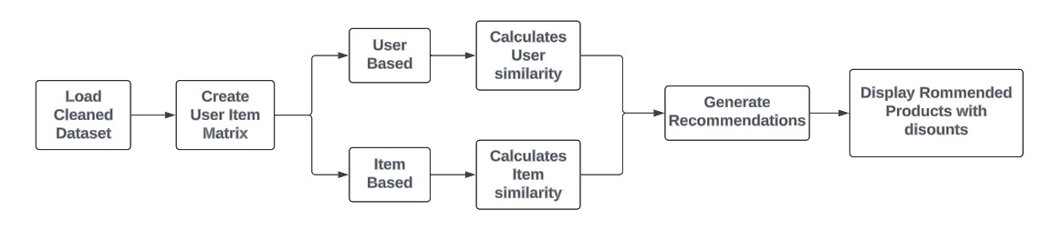
DFD Diagram - Recommendation module

Slide 31
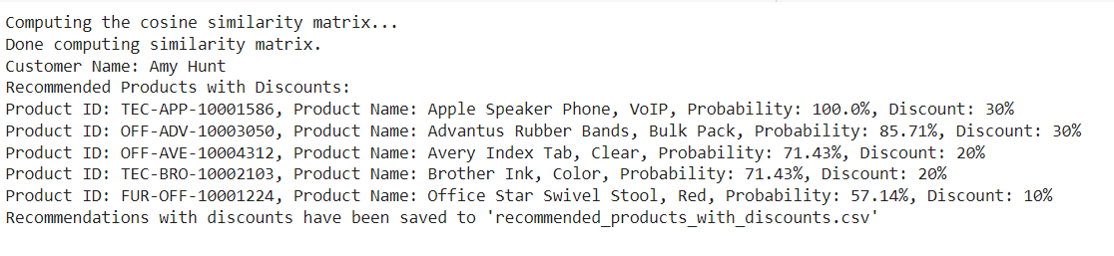
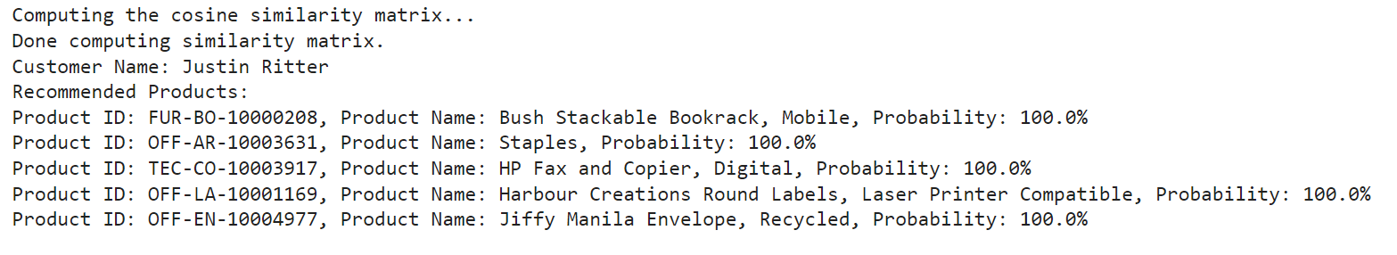
Output Screenshot
User Based Product recommendation

Slide 32
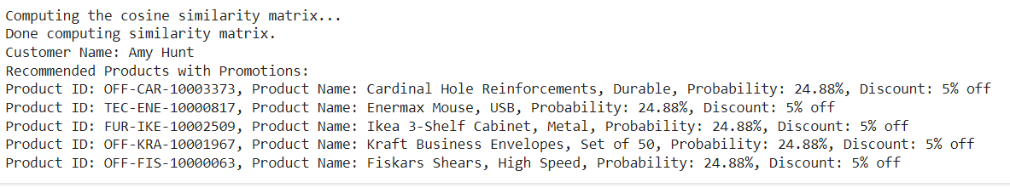
Output Screenshot
Item Based Product recommendation

Slide 33
Module 4:Promotion Personalization module
Step 1:First, for each customer and category, the total sales and total quantity are calculated by summing the sales and quantity per transaction.
Step 2:Then, fixed discount rates are assigned based on the product category, with Technology receiving a 15% discount, Furniture a 10% discount, and Office Supplies a 5% discount.
Step 3:The input features for the model are defined as total sales and total quantity.
Step 4:A Gradient Boosting Regressor is trained using these features to predict the discount rate.
Step 5:After the model is trained, it predicts the discount rate for each customer based on their total sales and total quantity.
Step 6:Finally, the discount amount is calculated using the formula: Discount Amount=(Predicted Discount × Total Sales)/100.

Slide 34
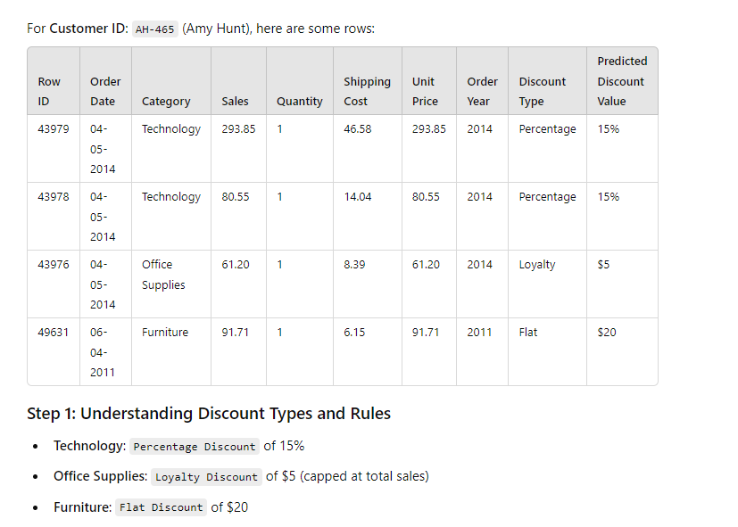
Gradient Boosting (Cal.)

Slide 35
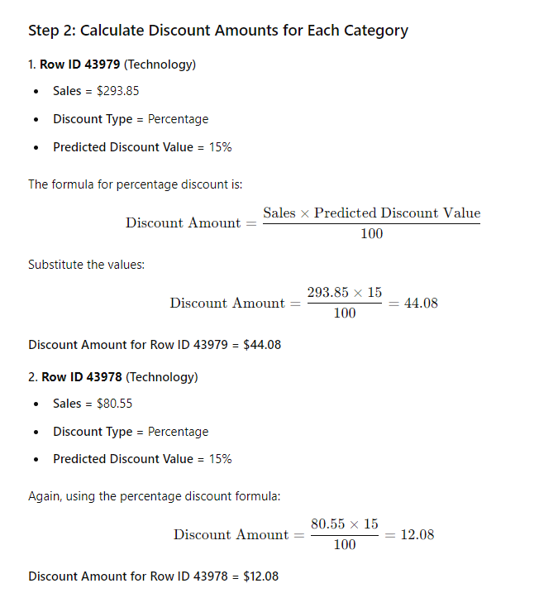
Gradient Boosting (Cal.)

Slide 36
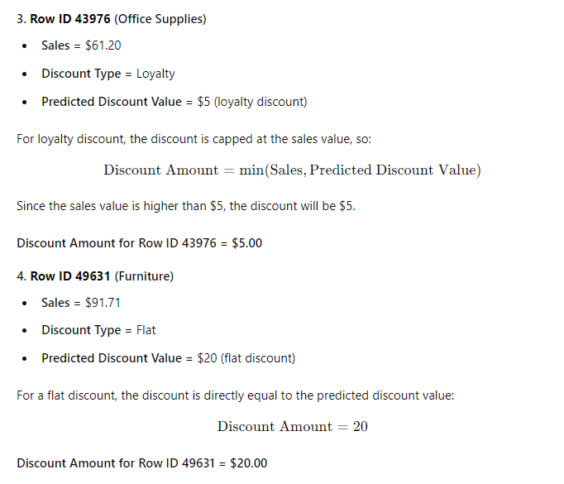
Gradient Boosting (Cal.)

Slide 37
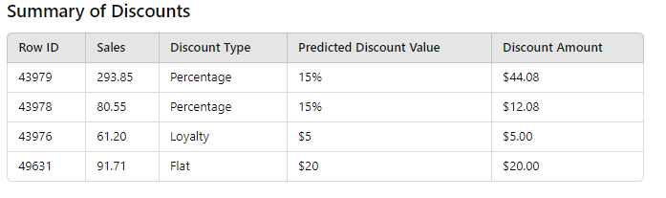
Gradient Boosting (Cal.)

Slide 38
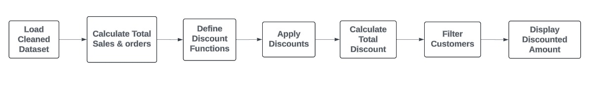
DFD Diagram-Promotion Personalization module

Slide 39
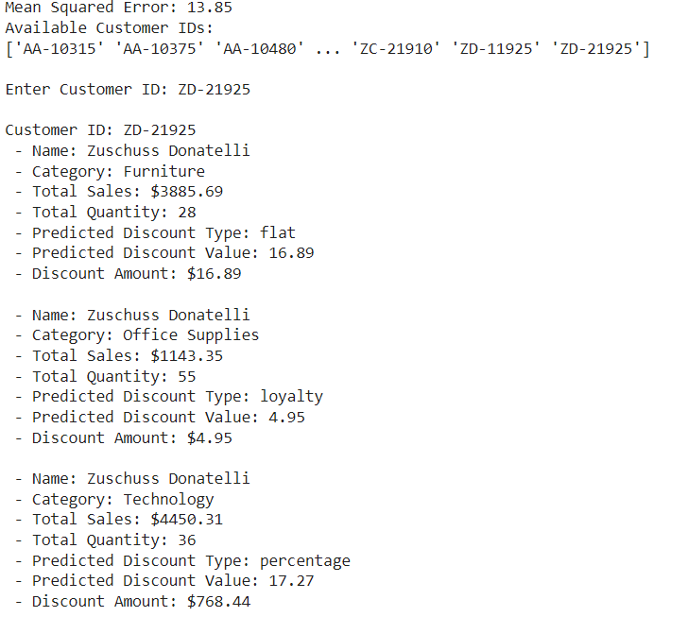
Output Screenshot

Slide 40
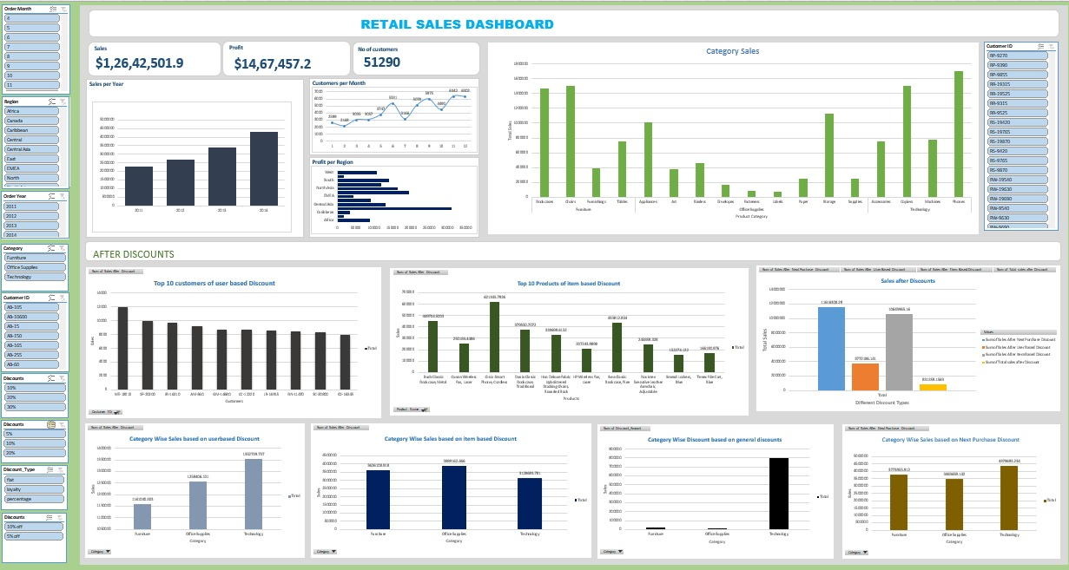
Analytics and Reporting Module

Slide 41
Comparative Analysis
Existing systems for recommendations and promotions operate separately, using methods like collaborative filtering and RFM models, which limit personalization and adaptability. They rely on static data and struggle with scalability. In contrast, the proposed system integrates recommendations and promotions, using ensemble methods and real-time analytics for personalized, dynamic strategies. This unified approach enhances scalability, relevance, and customer engagement, overcoming the limitations of traditional systems.

Slide 42
Conclusion
This project combines advanced recommendation techniques with personalized promotions to create a cohesive and customer-centric marketing solution. By integrating ensemble methods and collaborative filtering, the system delivers highly accurate recommendations paired with relevant discounts, boosting customer satisfaction and sales. The scalable and adaptive design addresses the shortcomings of traditional methods, setting a new standard for personalized marketing strategies in retail.

Slide 43
References.
Vesanen, J., & Raulas, M. (2006). Building bridges for personalization: a process model for marketing. Journal of Interactive marketing, 20(1), 5-20.
Chandra, S., Verma, S., Lim,W., Kumar, S., & Donthu, N.(2022). Personalization in personalized marketing: Trends and ways forward. Psychology & Marketing, 39(8), 1529-1562.
Dawn, S. (2014). Personalised Marketing: concepts and framework. Productivity, 54(4), 370-377.
Ball, D., Coelho, P., & Vilares, M. (2006). Service personalization and loyalty. Journal of services marketing, 20(6), 391-403.
Ho,S.(2006). The attraction of internet personalization to web users. Electronics users. Electronic markets., 16(1), 41-50.

Slide 44
Thank You

